Slide 1
TechLabs Düsseldorf x Huawei Hackathon

Slide 2
Nature Amigos
Chiang Yung-Hsuan
Lee Ming Cheng
Revan Dhanasekaran
Julia Alvarez
Nancy Nyambura

Slide 3
Project Idea
Let see what the current situation is….
Notes:
Dialog

Slide 4


Project Idea
Notes:
So what happend?
Lisa don‘t want to go out
she a mentioned couple of obstacles which can easily be solved
which WE solved by offering a tool
which not only sends a daily reminder to take a walk
but also offers a route nearby
andthe most important it provides informationa about the air pollution
to be more specific the (??? raven)

Slide 5

Project Idea
Air Quality
Green Areas
Short daily walking routes

Slide 6
Challenges Approach

Slide 7
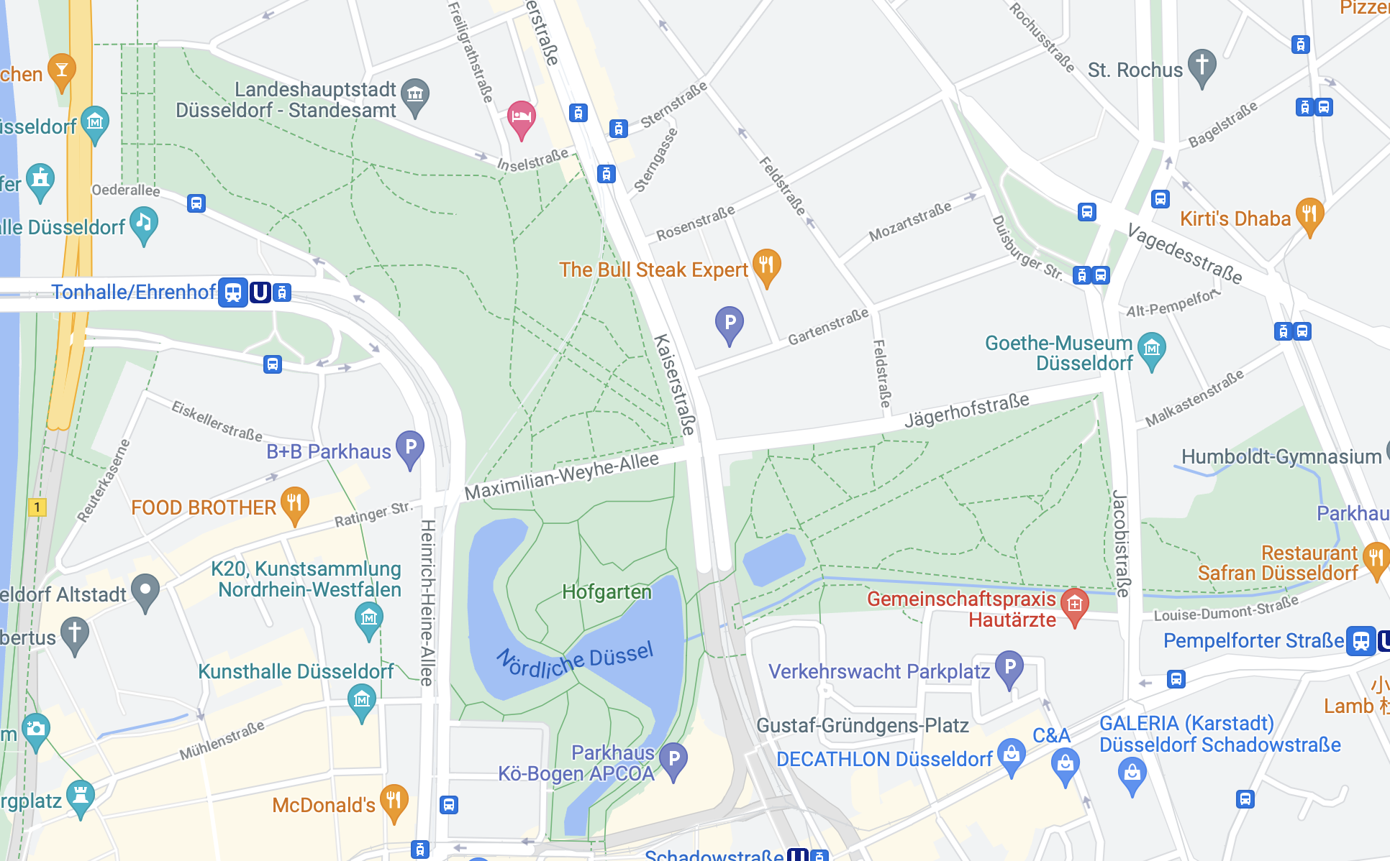

Route Planning
.gpx route data
latitude & longitude of jogging routes
Notes:
the unique part about our approach is that
we did not use third party data
but

Slide 8
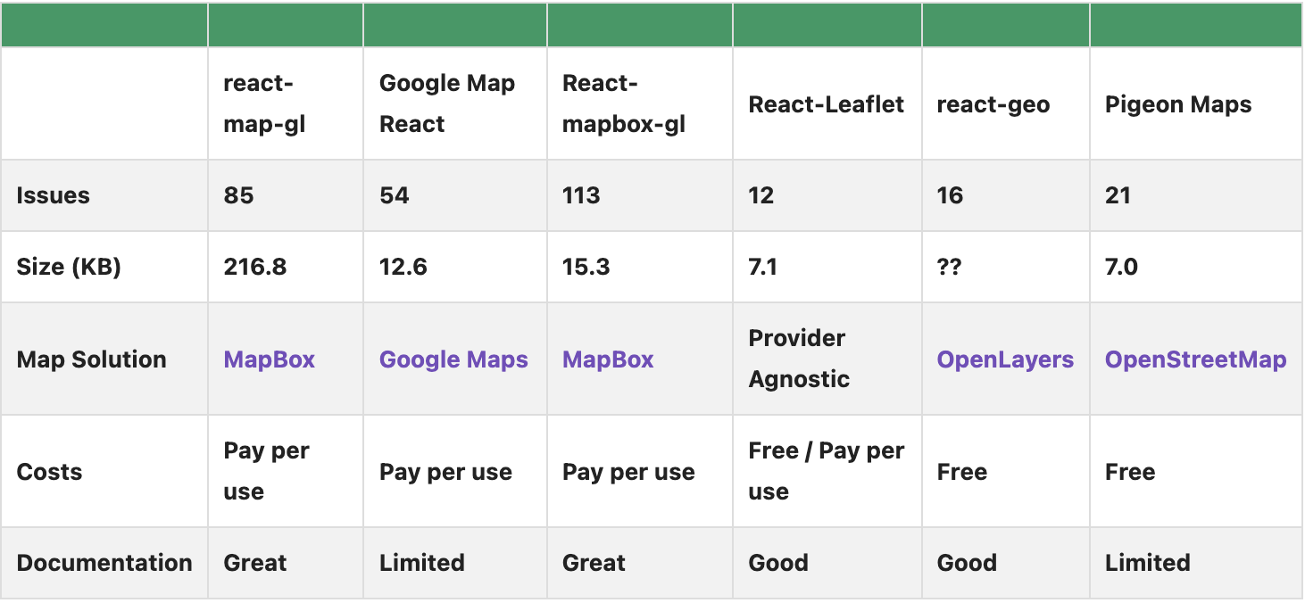
Technical Challenges
Choosing the right map
CSS styling

Slide 9
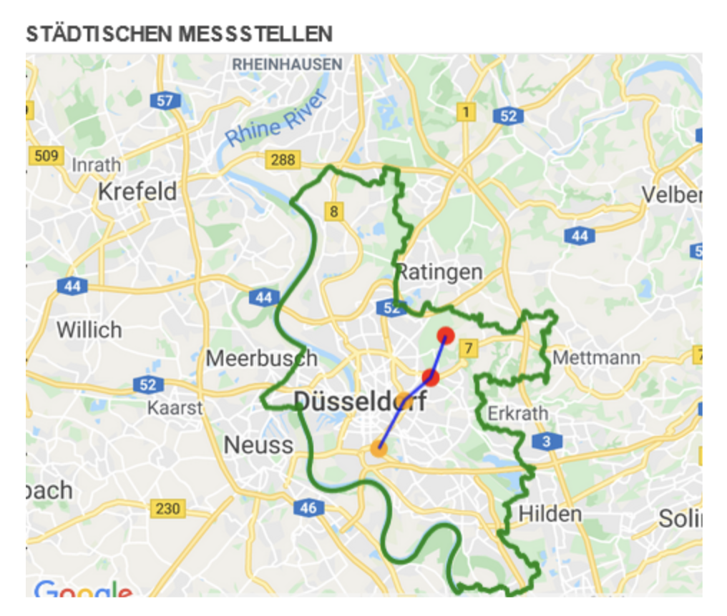
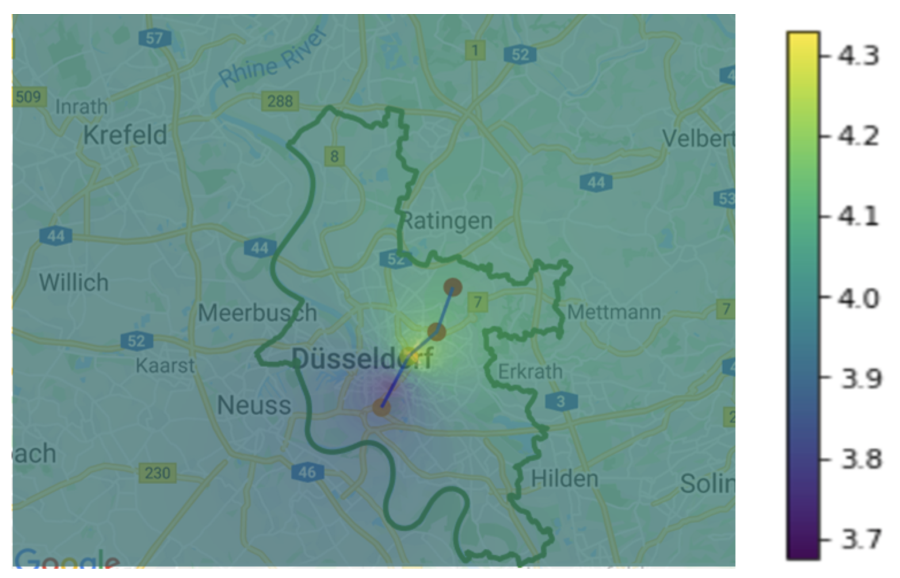
Air Quality Index
No direct air quality index dataset.
Only two measurement stations currently active.
Availability of few pollutant data such as dust and NOx.
Calculated air quality index in the scale of 0-5 by averaging the pollutant values.
Interpolating the air quality over the region from two stations.
Notes:
the unique part about our approach is that
we did not use third party data
but

Slide 10
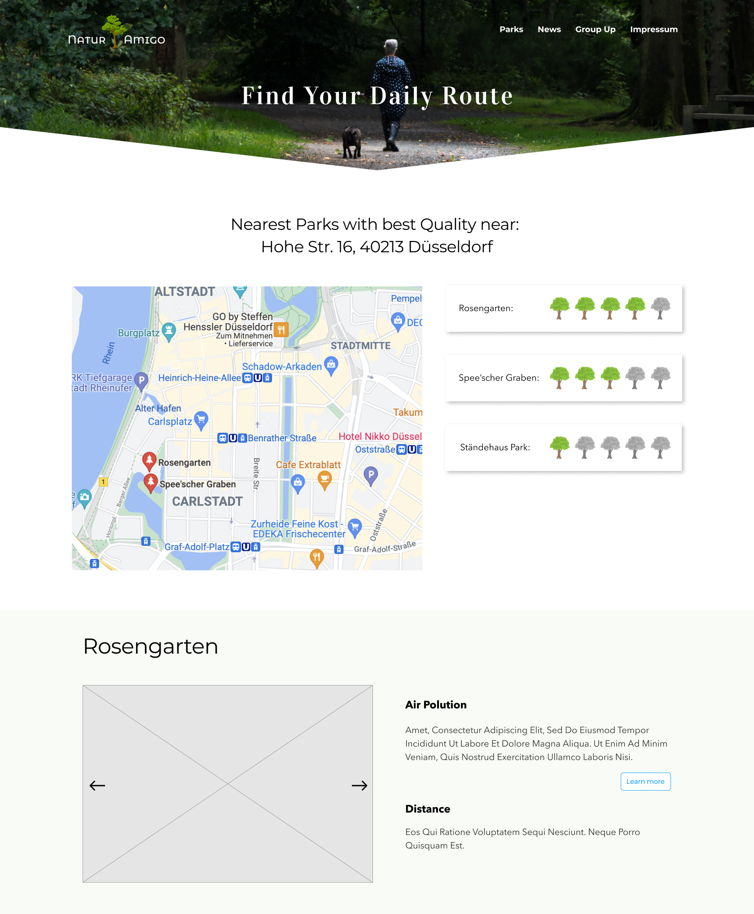
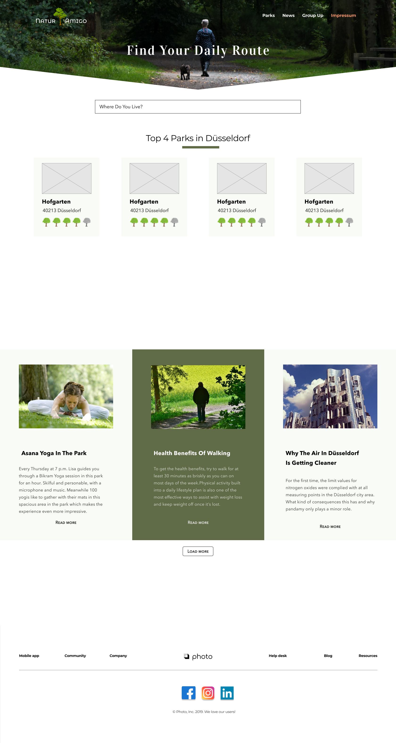
Interface Design

Slide 11
Results
Now lets see what changed!

Slide 12
Further development opportunities
Gathering Community
roaming together
park cleaning groups
Basis for Forecasts
Rhine water level – Flood warning system
Weather

Slide 13
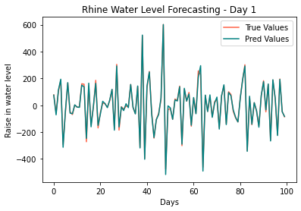
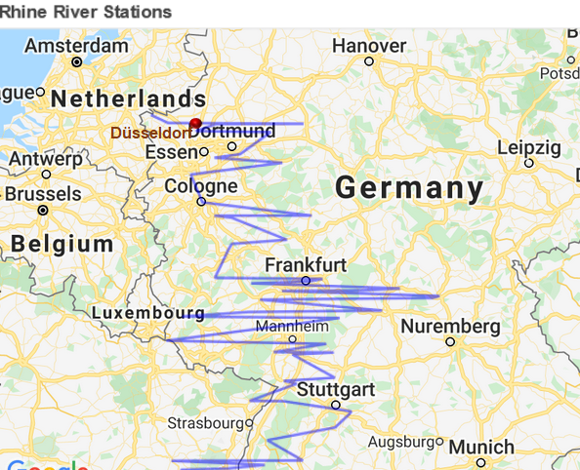
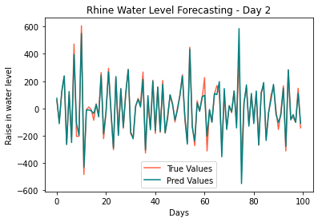
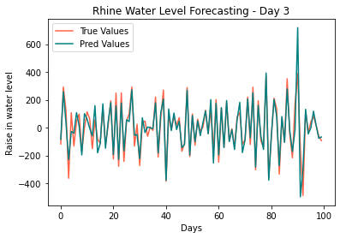
Rhine water level forecast

Slide 14
Thank you for listing! ☺

